Slide 1
@sharedhealthgm

Slide 2
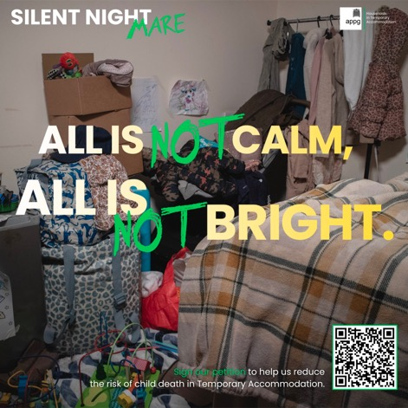
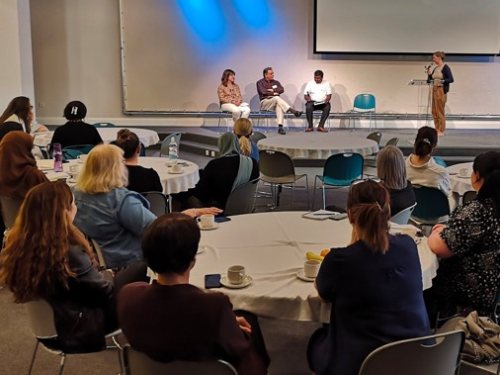
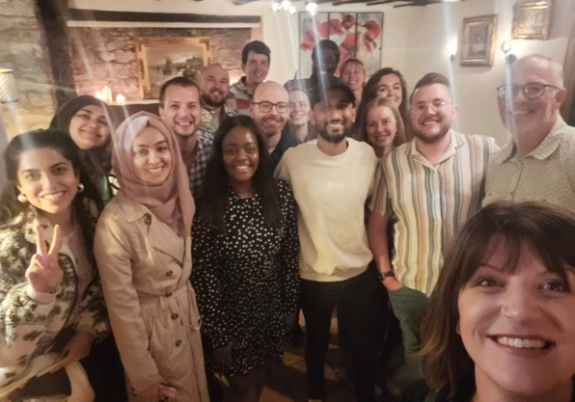
•Non-profit (philanthropically-funded)
•Mix of health clinicians and non-health backgrounds
•Health-focused but cross-sector
Innovate on the ground projects whilst also lobbying and system change

Slide 3
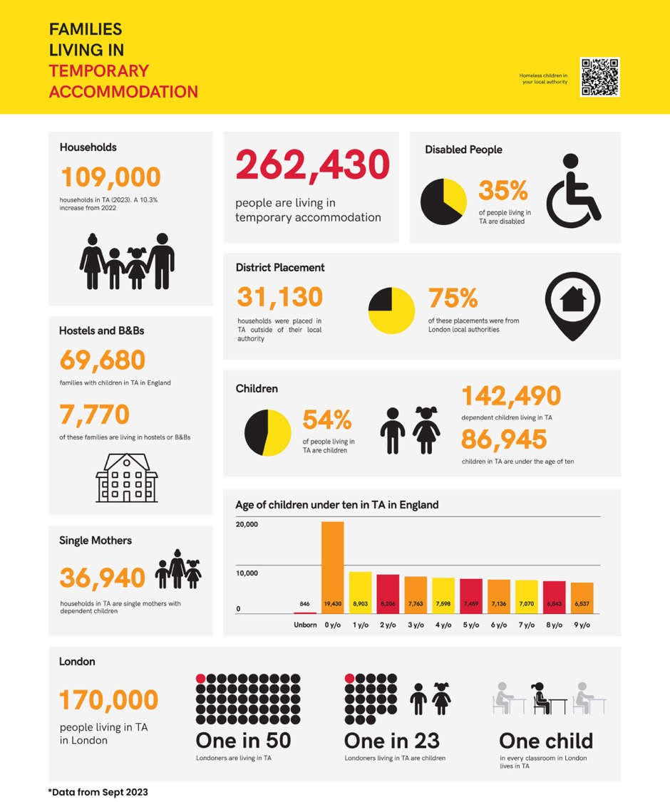
Notes:
Now 145,000

Slide 5
Suffering produces perseverance; perseverance, character; and character, hope

Slide 6
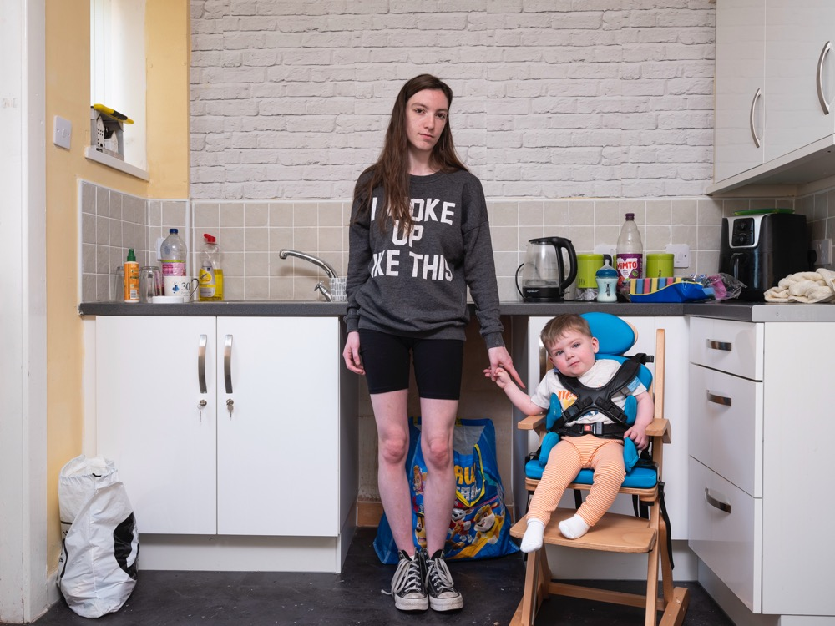
I was living on my sister's sofa. So, I'd moved into my dad’s. He'd been handed a eviction notice from his landlord. The council wouldn't help until the day we literally had nowhere to go, and then they then put us into temporary accommodation. We were, like, just living out of bags, pretty much. We used to have to leave the pram at the bottom of the stairs, carry my child up, and then run back down dead quick for the pram. You might have a dark day now, but in years to come, a couple of months’ time to come, when you are over and outta that dark place, you will look back and you'll think. ‘I did it. I did that for my babies.’ And, if you can do that and get through that, then you can conquer the world.

Slide 14
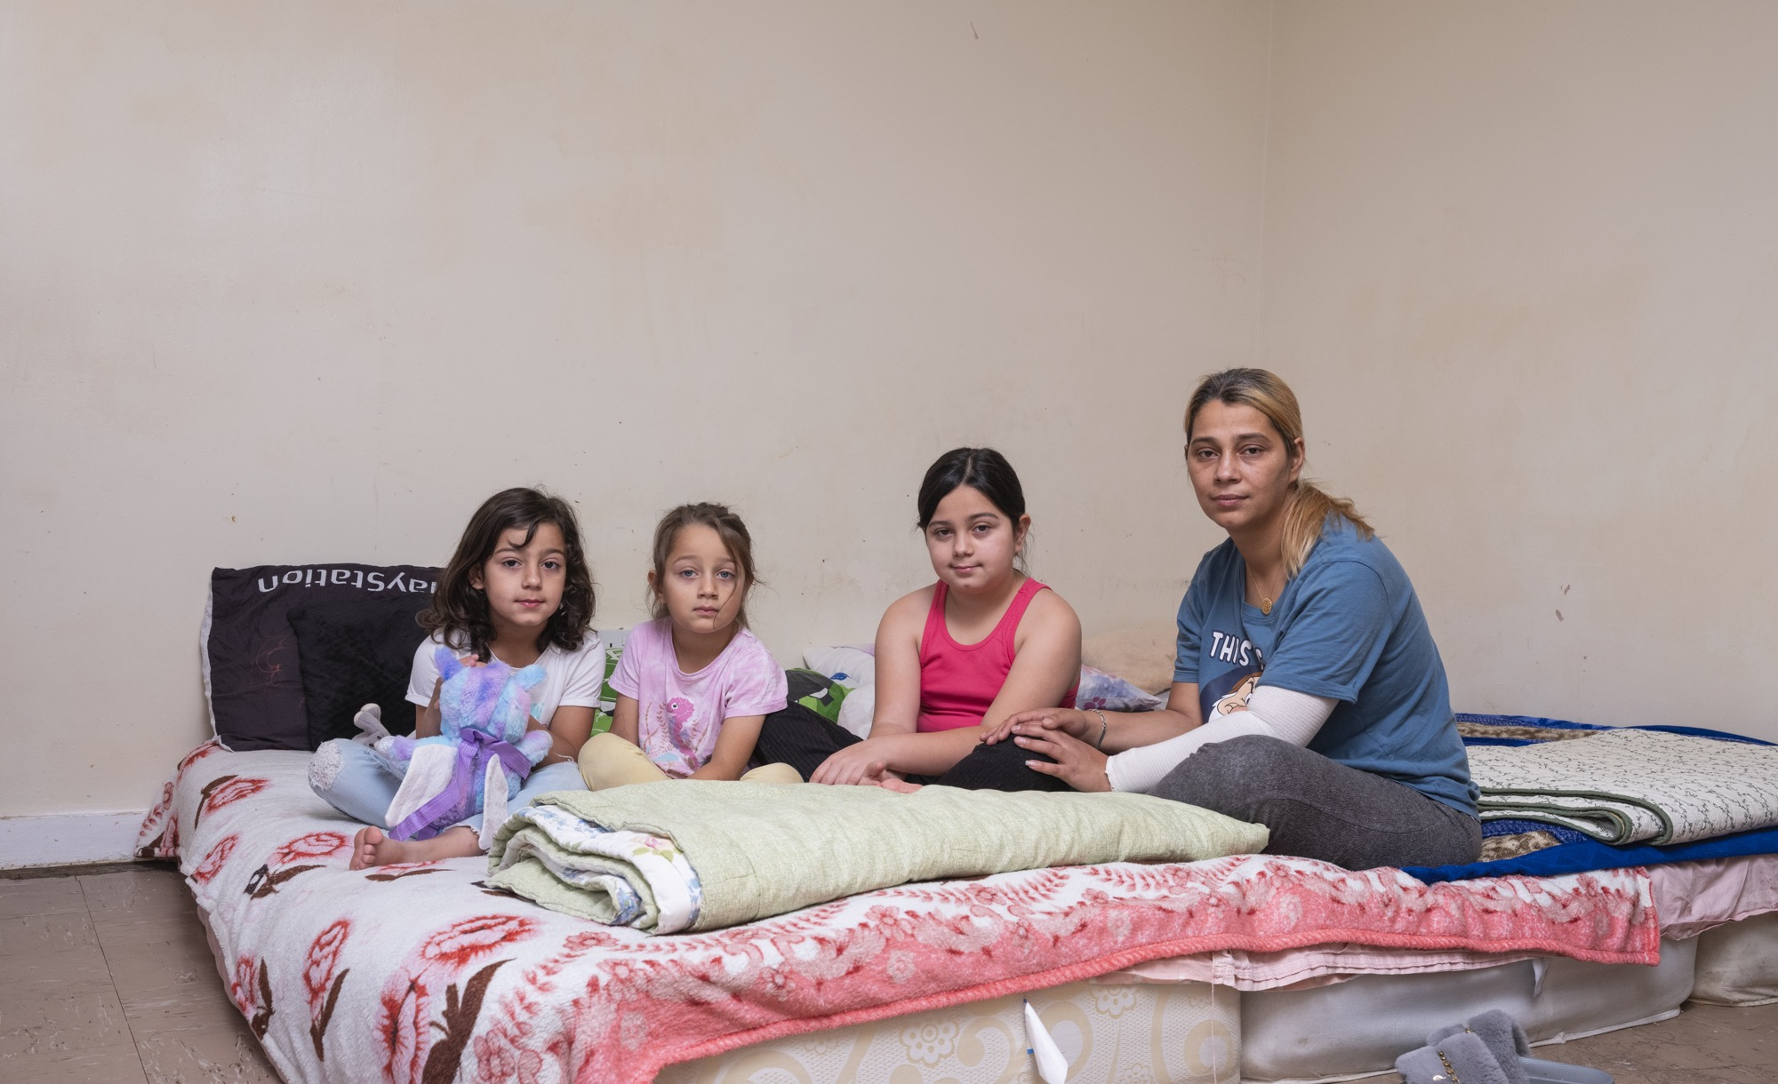

Slide 16
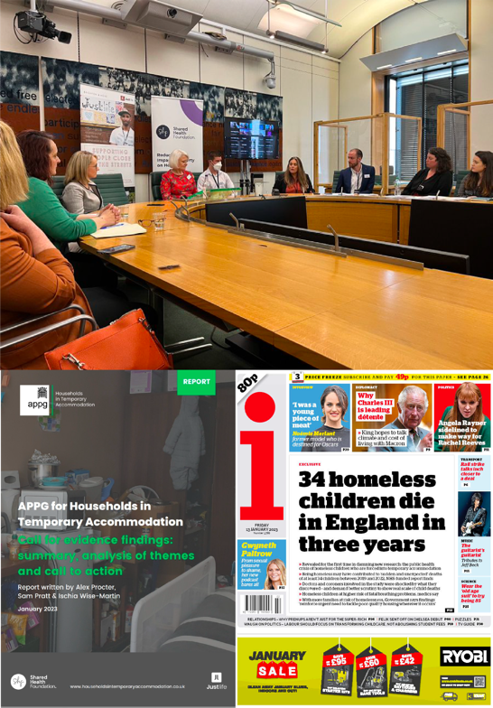
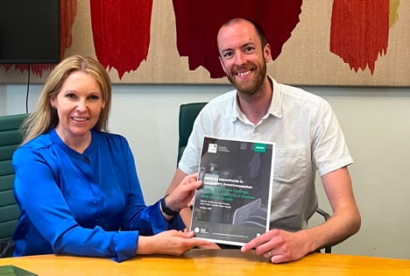
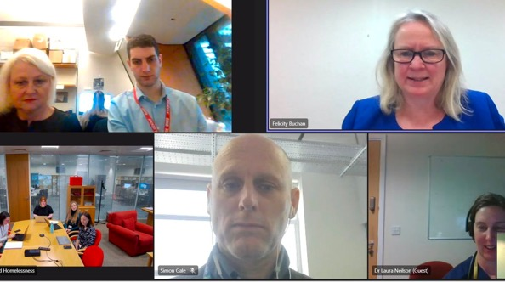
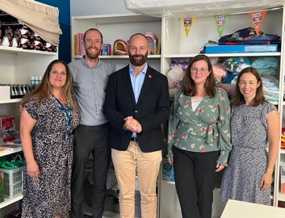
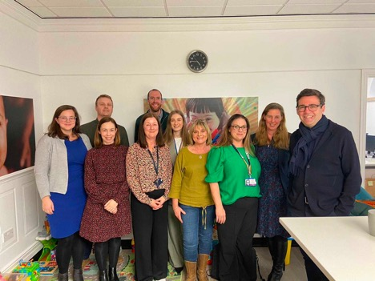
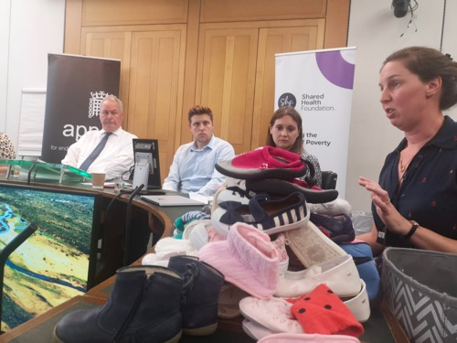
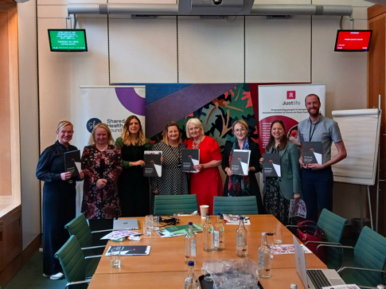
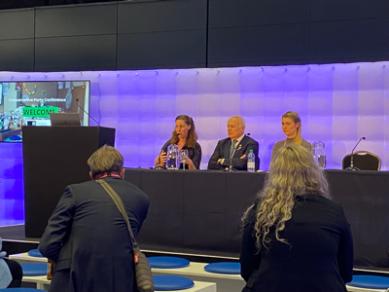
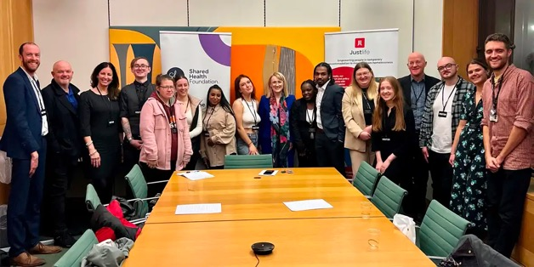
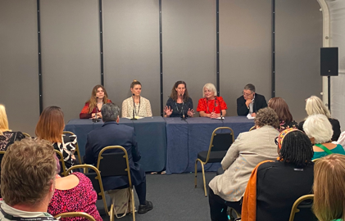

Slide 17
Practical solutions for the frontline
Cot for every infant for every night.
Data, data, data (code your families living in TA, Primary and Secondary Care, code accidents and near misses)
Notification system (linking up Health, Housing and Education)
Challenge. (No mixing singles and families in accommodation)
The Crib. (Replicable service for local authorities)
Tell us what is going on (more stories and data the better)

Slide 21
Justlife
Advocating for and with people experiencing homelessness in temporary accommodation.
Justlife.org.uk

Slide 22
Key areas of focus:
Services in Manchester, and Brighton & Hove
Focus: single households
1-2-1 support, social connection and befriending
National
Research & Policy – including All-Party Parliamentary Groups (AAPG)
The Temporary Accommodation Frontline Network (TAFN)
Networks and Temporary Accommodation Action Groups (TAAGs)
TAAGS across the country (including a focus on families in temporary accommodation
Cross-sector Networks in Brighton & Hove, and East & West Sussex

Slide 23
National TA Network
Temporary Accommodation Action Groups (TAAGS)
Finding Solutions to local problems
Existing TAAGS
How to set up your own guide
TA Frontline Network
Regular slot in the newsletter
Resources
Online meet-ups (the next one’s 2pm-3.30pm, 26th June)
Updates on Households in TA – APPG
TO CONNECT: SIGN UP TO NEWSLETTERS

Slide 25
“Even if you’re little, you can do a lot” Matilda

Slide 26
Sam.pratt@sharedhealth.org.uk
@sharedhealthgm
sharedhealthfoundation.org.uk

