Slide 1
Frontline Network Annual Conference 2023
Empowering frontline workers across the UK

Slide 2
"In my role I often feel isolated and alone and knowing there is a group that is listening to our concerns helps"
Frontline Worker event attendee

Slide 3
Today’s event
Join for one session or the whole day!
All sessions are being recorded as webinars and will be shared afterwards via our website
Throughout the day, please get involved:
Share comments and questions via the Chat and Q&A box
Join the conversation on Twitter @SMITF_frontline #WorkingTogether

Slide 4
Our schedule - morning
10:00am - 10:30am We are kicking things off with our opening plenary, for which we are excited to have Viki Fox, Policy & Participation Manager, Cyrenians, present.
10:30am – 11:30am 4 Nation Roundtable Discussion, with Viki Fox plus Katie Dalton, Director, Cymorth Cymru, Mark Baillie, Homeless Connect and Jeremy White, Head of National Partnerships, Homeless Link
11:50am – 1:00pm Morning sessions:
Health and Homelessness
Housing Legislation - A Bite-Sized Policy Update on Key Changes Across the 4 Nations
Accessing support and resources for people living in temporary accommodation
Immigration Advice and Guidance

Slide 5
Our schedule - afternoon
2:00pm – 3:00pm Roundtable Discussion: Supporting the Wellbeing Of Our Frontline Staff
3:20pm – 4:20pm Afternoon sessions:
Resilience and Wellbeing
Boundaries and your Wellbeing workshop
Mindfulness & Compassion Based Self-Care Techniques
4:30pm Finish

Slide 6
Let's get to know each other...
Join in with our icebreaker on menti.com

Slide 7
An update from the Frontline Network
Our activities 2022-2023

Slide 8
We support workers from the public, statutory and voluntary sectors across the UK, working on the frontline with people experiencing homelessness.
Funding
Community
Resources

Slide 9
The Vicar’s Relief Fund
In 2022/23 you submitted a total of 5,536 applications to the VRF. Thanks to the generous support of our donors, the VRF continued to provide small, quick grants to prevent eviction and help people access accommodation:
Total grants:
4,832​
Total spend:
£1,768,762.52
Total beneficiaries:
8,086

Slide 10
Training Fund
“Many thanks for your help and support with the funding. You enabled us to offer some quality training for our staff and improve our service for the young people we work with.”
What staff told us after receiving funding via our Training Fund

Slide 11
Frontline Fund
Launched in 2022 the Frontline Fund supports six projects across the four nations of the UK. The projects each focus on supporting people to secure, and keep, a safe place to live. This includes providing access to healthcare, legal advice and mental health support to help people move on from homelessness.
In 2022/23, £398,279 was allocated to the six recipients of the Fund; Caring in Bristol, TGP Cymru, Legal Services Agency, akt, Pathway and Extern.

Slide 12
Local Networks
Cyrenians - Scottish Frontline Network and All in For Change
Cymorth Cymru - Frontline Network Wales
Homeless Connect - Northern Ireland Frontline Network
Justlife - Brighton and Hove Frontline Network
Praxis - Pan-London Migrant Frontline Network
Street Life Trust - Blackpool, Wyre and Fylde Frontline Network
Coventry Citizens Advice - Coventry Frontline Network
Path - Plymouth Frontline Network
Basis Yorkshire in partnership with Together Women and Leeds Women’s Aid - Leeds Women’s Homelessness and Housing Frontline Network
Depaul UK - South Yorkshire Frontline Network

Slide 13
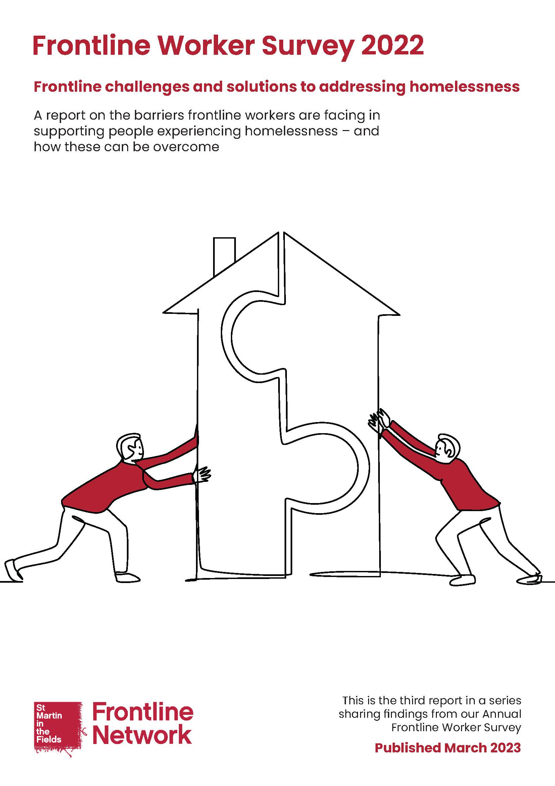
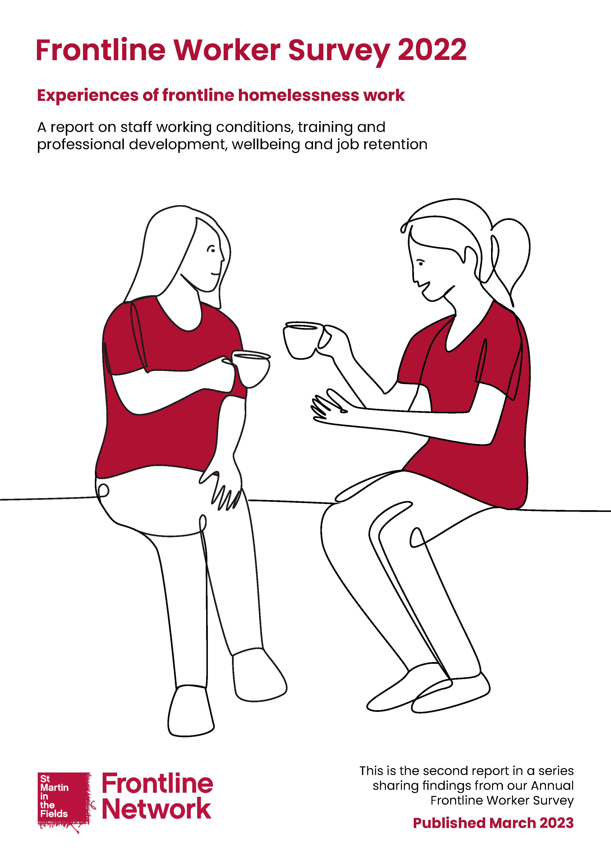
Frontline Worker Survey 2022
Our most recent survey was undertaken in November - December 2022 and we received responses from 1,182 frontline workers across the UK.
We asked you questions exploring:
Access to accommodation
Access to support services
Frontline worker wellbeing and development
We released 3 reports to explore the findings:
1. Early Findings (December 2022)
2. Experiences of frontline homelessness work (March 2023)
3. Frontline challenges and solutions to addressing homelessness (March 2023)

Slide 14
Survey findings – key takeaways
The majority of frontline workers are seeing an increase in need of their homelessness services.
Staff reported significant issues when it came to accessing accommodation for people facing homelessness.
Frontline workers themselves are also being significantly affected by the rising cost of living.
Frontline workers are also working under extremely challenging conditions. This is having a significant impact on staff wellbeing and threatens to force frontline workers to leave the sector.
To address homelessness, we need to ensure the right resources are available. This means accessible, suitable accommodation as well as appropriate wider support where needed, particularly around healthcare.
We need to remove the barriers which stop people being able to access accommodation and support, to ensure services are inclusive of all people. We need to improve policy and practice
now to address and, crucially, prevent homelessness wherever possible.

Slide 15
Survey findings – change needed
91%
Found it 'very difficult' or 'difficult' to access specialist accommodation
88%
Observed that long waiting lists 'often' or 'always' presented barriers to people accessing support services
58%
Felt that your role had a negative impact on your wellbeing

Slide 16
Want to find out more?
Further details about the funding, community and resources available to support frontline staff can be found on our website www.frontlinenetwork.org.uk.
And you can be the first to hear updates by signing up to our monthly e-newsletter and following us on Twitter @smitf_frontline.

Slide 17
“It's great to have a space for frontline workers to network and feel listened to, with a focus on wellbeing”
It’s not about us, it’s about you.
We work with your ideas and expertise, finding ways to help best support you and your work.
“I'm not just a small cog but part of a wider group, a hive of like-minded and warm hearted people”
“[I feel] hopeful about changes that can be made, new organisations to work with and hearing about actions other organisations are implementing”
“People outside my organisation experience the same issues & difficulties as I do. Phrases such as vicarious trauma, compassion fatigue give a phrase to define how we often feel!”

Slide 18
4 nation roundtable discussion
A roundtable discussion with Viki Fox plus Katie Dalton, Mark Baillie and Jeremy White

