Slide 1
Frontline Network Annual Conference 2023
Immigration Advice and Guidance
Bethan Lant, Praxis Migrant Frontline Network
Tom MacPherson, NACCOM
Eiri Ohtani, Right to Remain
Caroline Higgins, Coventry Refugee and MIgrant Centre

Slide 3
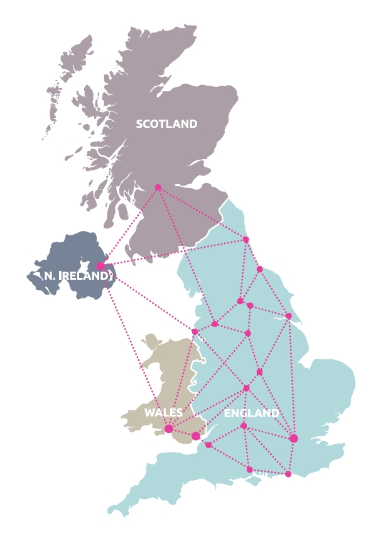
NACCOM
A very diverse
Network of 135
Members
(c. 70 provide accommodation)
Our Vision:
A commitment to bringing an end to destitution amongst people seeking asylum, refugees and migrants with no recourse to public funds living in the UK.
Our Mission:
To promote best practice in and support the establishment of accommodation projects that reduce destitution amongst people seeking asylum, refugees & migrants with no recourse to public funds.
www.frontlinenetwork.org.uk/funding

Slide 4
Who our members support
Core focus: people who have had their asylum claim refused and have been left with NRPF.
Legitimate asylum claims are often refused. There are many factors that contribute to this, for example…
Poor HO decision making
Lack of evidence
Trauma leading to inconsistencies and credibility issues
Poor or no legal representation / dysfunctional Legal Aid system

Slide 5
Issues and challenges in delivering accommodation

Slide 6
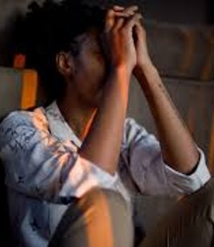
NRPF
Restricted eligibility for statutory support = charities have to fill the gap
Much harder to engage with legal support and other services without a roof over your head
NRPF condition causes significant harm:
Increases poverty, isolation
Deterioration in both physical and mental health.
Risk of exploitation, e.g. forced labour
Individuals become unseen, unheard, ignored
Prevents people being able to exercise their rights

Slide 7
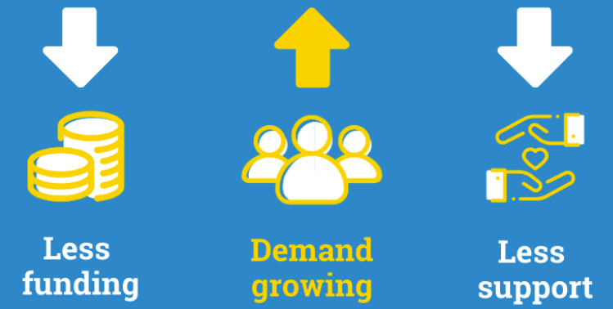
Post-Covid challenges
Some funding streams have dried up
Reduction in drop-ins and other safe spaces for people to go to for support = more hidden homelessness

Slide 8
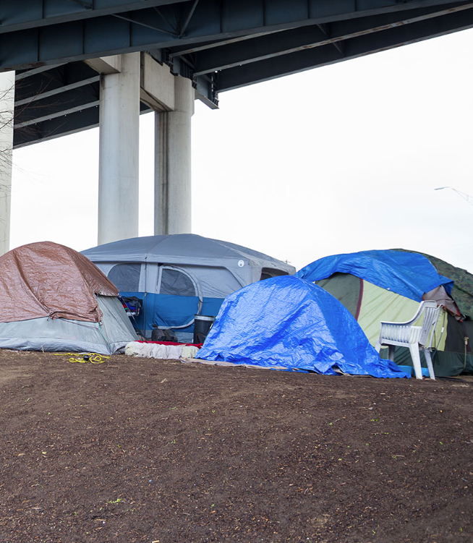
Increased destitution among people with refugee status
Why?
Housing crisis
28-day move-on period
Inconsistent approach taken by LAs
Some consider refugees priority need whilst others don’t
Streamlined Asylum Process
Likely to see a significant rise in people receiving both positive and negative decisions, but in both cases facing destitution

Slide 9
New dispersal system
Increase in accommodation for people in the asylum system in places with no support services and increased hostility
Concerns over quality of accommodation, especially given the loosening of HMO requirements
Likely to lead to:
more mental health issues
more people absconding
lower engagement with legal support = less chance of successful asylum claim
Ultimately, more homelessness in areas with less support

Slide 10
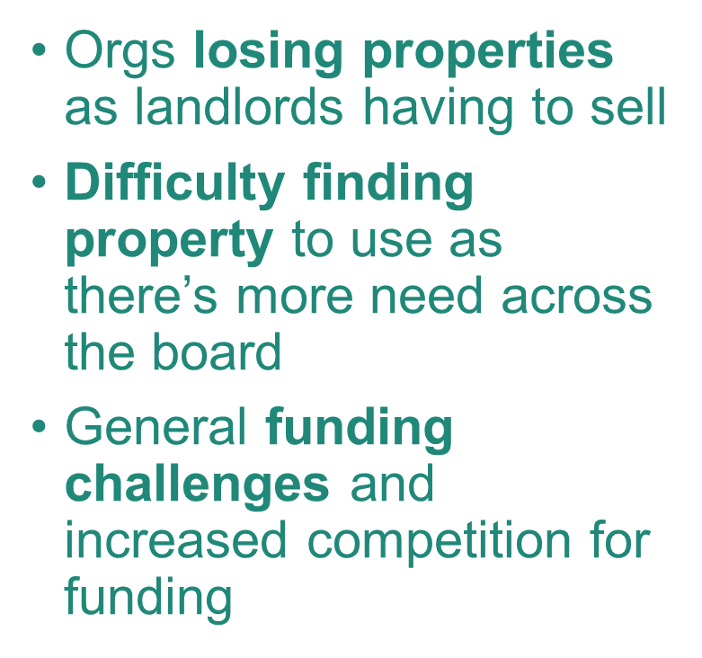
Rise in complex health needs
Cost of Living
Likely contributing factors:
Failing asylum system = longer periods waiting and/or destitute
Housing crisis = longer periods destitute
Most organisations aren’t set up to support people with complex needs = lack of expertise

Slide 11
Fear of hostile legislation
More people ‘going underground’ / sofa surfing / not presenting to support services / avoiding asylum system altogether
… To avoid harmful impacts of new policies, e.g. being sent to Rwanda
Will be greatly exacerbated by the ‘Illegal Migration’ Bill

Slide 12
Founder member of NACCOM, started by NACCOM’s Founder Dave Smith in 2004.
Cross-subsidy model providing 34 Refugees & 47 NRPF asylum beds
21 shared houses: 2 leased from Arawak Walton housing association, 4 from Green Pastures, 15 from supporters (churches & supportive landlords on free, low or peppercorn rents).
Service level agreement with Arawak Walton, who provide all housing management (repairs, maintenance, emergency call out etc.) & rent collection for those with status.
Casework and wrap-around support by Boaz Staff with 98% of NRPF clients accessing legal advice (57% from GMIAU)
https://www.boaztrust.org.uk

Slide 13
Rent properties from Framework and Tuntum housing associations at local housing allowance (LHA) rate. The houses are set up and managed as small HMOs.
NAT receive a higher income than the LHA family rate by letting individual rooms to newly granted refugees as part of a cross-subsidy portfolio.
The properties house a varying mixture of rent-paying refugees and people seeking asylum with NRPF.
Both housing associations provide a full repairs and maintenance service and emergency callouts.

Slide 14
Hosting Project
Progress in developing hosting in London was slower than other cities, so HJ applied for funding for a Coordinator and set up a hosting project in 2015.
Now has a dedicated Coordinator and Officer.
All guests must be receiving immigration advice or legal support (including through HJ partnership with Cardinal Hume Centre), with a move-on plan.

Slide 15
How we support members
Toolkits and other resources
Opportunities for networking, info sharing, and peer-to-peer support
Regional hubs
Thematic hubs
Member calls
Slack channels
Google Group
1:1 support, e.g. to broker introductions and discussions, and support members to explore potential projects and partnerships
Policy, Advocacy and Campaigning work and updates
Annual Members’ Survey
Evidence of the scale and impact of destitution that helps us to shape campaigns.
Support around data collection
Training courses, e.g. on wellbeing support
Media opportunities and guidance

Slide 16
The ‘Illegal Migration’ Bill
Refugee Council : After 3 years, 161,147 to 192,670 people will have had their asylum claims deemed inadmissible but not have been removed… → Hundreds of thousands:
Rough sleeping
In hidden homelessness
In exploitative conditions, incl. trafficking and modern slavery
How to reach people fearful of approaching services for support?
Need grassroots partnership work with potential first responders (places people first go to for support/community): cafes, restaurants, faith groups, foodbanks.
Responsibility of migrant sector to inform such institutions about implications of the Bill and how to support people without putting them at risk
How to accommodate people with no move-on potential?
How to communicate to funders who are focused on ‘outcomes’?
Need to change funders’ ideas of what ‘outcomes’ means. Saving people’s lives and providing a sense of community will be priority

Slide 17
Right to Remain Toolkit: a guide to the UK asylum and immigration system
Eiri Ohtani, Right to Remain - 29 June 2023

Slide 18
About Right to Remain
- We are a national migration justice organisation, formerly National Coalition of Anti-deportation Campaigns
- Best known for its Right to Remain Toolkit, which was used by nearly a third of a million people in 2022/23, to navigate the UK’s complex and hostile asylum and immigration system
- Promotes legal support (as distinct from legal advice) as a tool to build radical solidarity that protects everyone in our community
www.frontlinenetwork.org.uk/funding

Slide 19
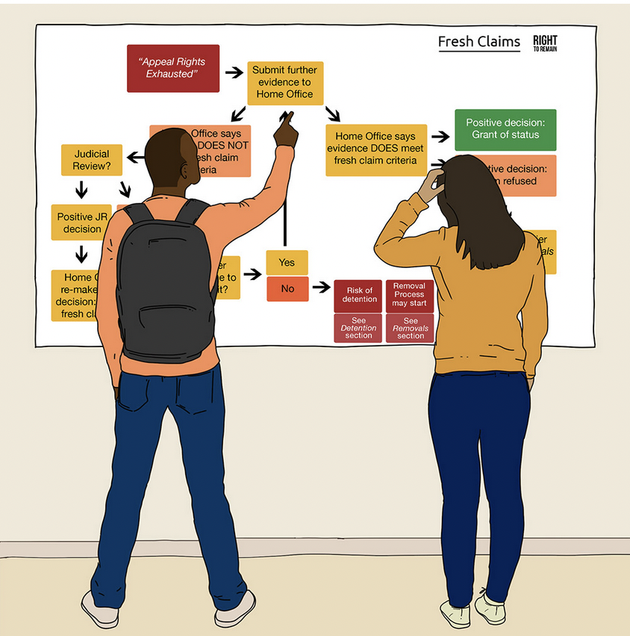
The Right to Remain Toolkit
Free, on-line resources
Developed for and with people going through the system and non-specialists
Step-by-step guide
Know your rights!
Information and action
Used by hundreds of groups to support their members/users and for staff and volunteer training

Slide 20
Context – our community
The impact of new laws (the Nationality and Borders Act and the Illegal Migration Bill) – more destitution, detention, limbo, disengaging from the system, confusion, fear
Lack of accurate, clear information – much misinformation
For many, it’s impossible or very hard to get legal advice. And many feel ashamed about their insecure immigration situation
More people in undocumented or precarious immigration status, who struggle to surive and regularise their status – leading to harm of poverty and homelessness
Endemic ‘crisis’ of destitution, mental health etc worsened by the cost of living crisis - existing refugee/migrant support groups are beyond being overstretched & having to change our approach

Slide 21
Context - legal advice deserts
The area of immigration and asylum law is incredibly complex and fast changing – hard to understand, hard to navigate
The demand for legal advice has always outstripped the supply of legal advice – this will not change in the foreseeable future
Legal aid availability – this will not dramatically increase in the foreseeable future
Legal practitioner availability – this will not dramatically increase in the foreseeable future
Legal advice infrastructure – this will not dramatically improve in the foreseeable future
Geographical barriers – many areas are already ‘legal advice deserts’ and new areas of need are popping up everywhere

Slide 22
Some illustrations
The greatest area of needs – non-asylum immigration and nationality matters. The estimated number of undocumented people in the UK is 809,000 people, including children.
‘The majority of Wales is without any immigration and asylum advice at all above Level 1.’
‘The South West - Across the region, there were 11 legal aid provider offices, almost all in the city of Bristol... One of these providers withdrew from legal aid in early 2022. There is one small provider in Plymouth, with a single caseworker, and one provider with a contract in Wiltshire, which has been unable to do any legal aid work as it cannot recruit a lawyer.’
See NO ACCESS TO JUSTICE: HOW LEGAL ADVICE DESERTS FAIL REFUGEES, MIGRANTS AND OUR COMMUNITIES (MAY 2022)

Slide 23
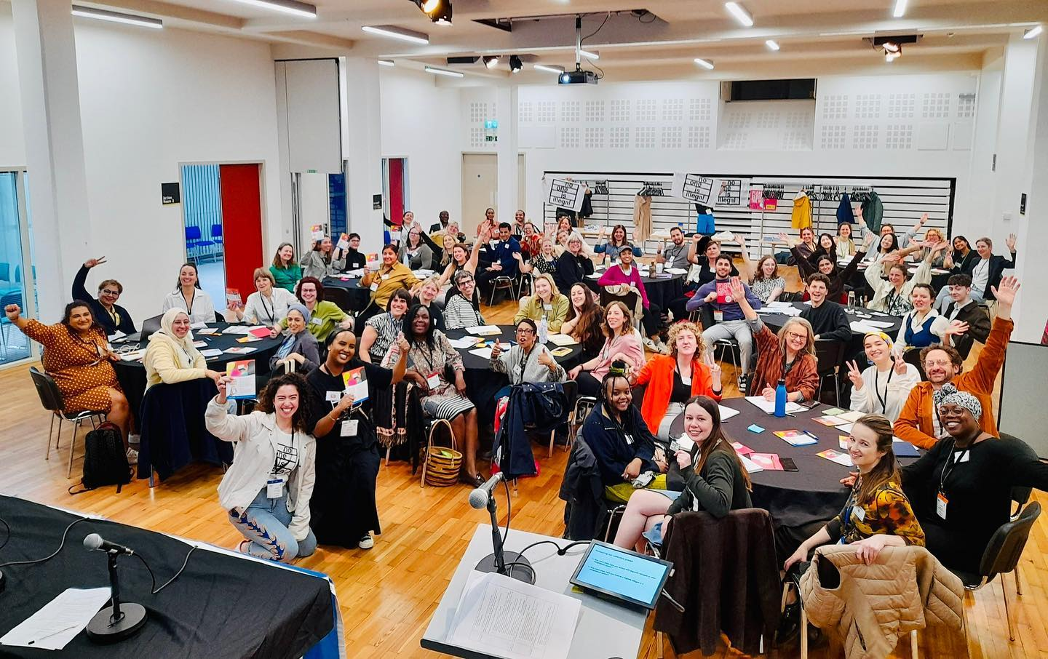
Toolkit Festival London – 17 May

Slide 24
Who can give immigration advice?
It is illegal for anyone who isn’t accredited with OISC (The Office of the Immigration Services Commissioner) of or another regulatory body to give legal advice in asylum or immigration cases.
Legal advice is specific, direct, & proposes a course of action (applications of legal rules and principles to a specific set of facts that proposes a course of action).
If you are not qualified to give legal advice, you can still give legal information. Legal information is factual, generic and does not address any one particular cause of action.
https://righttoremain.org.uk/toolkit/yourlegalcase/#accredited

Slide 25
What is legal support?
If you are not qualified to give legal advice, you can still share legal information. Legal information is factual, generic and does not address any one particular cause of action. For example, the information in the Toolkit.
Providing legal information about the asylum and immigration systems is one form of legal support. This could be explaining how the asylum and immigration system works, what the most recent country guidance case on a certain country is, or explaining what an “injunction” is. This is not providing legal advice; it is sharing information.
https://righttoremain.org.uk/toolkit/legal-support/

Slide 26
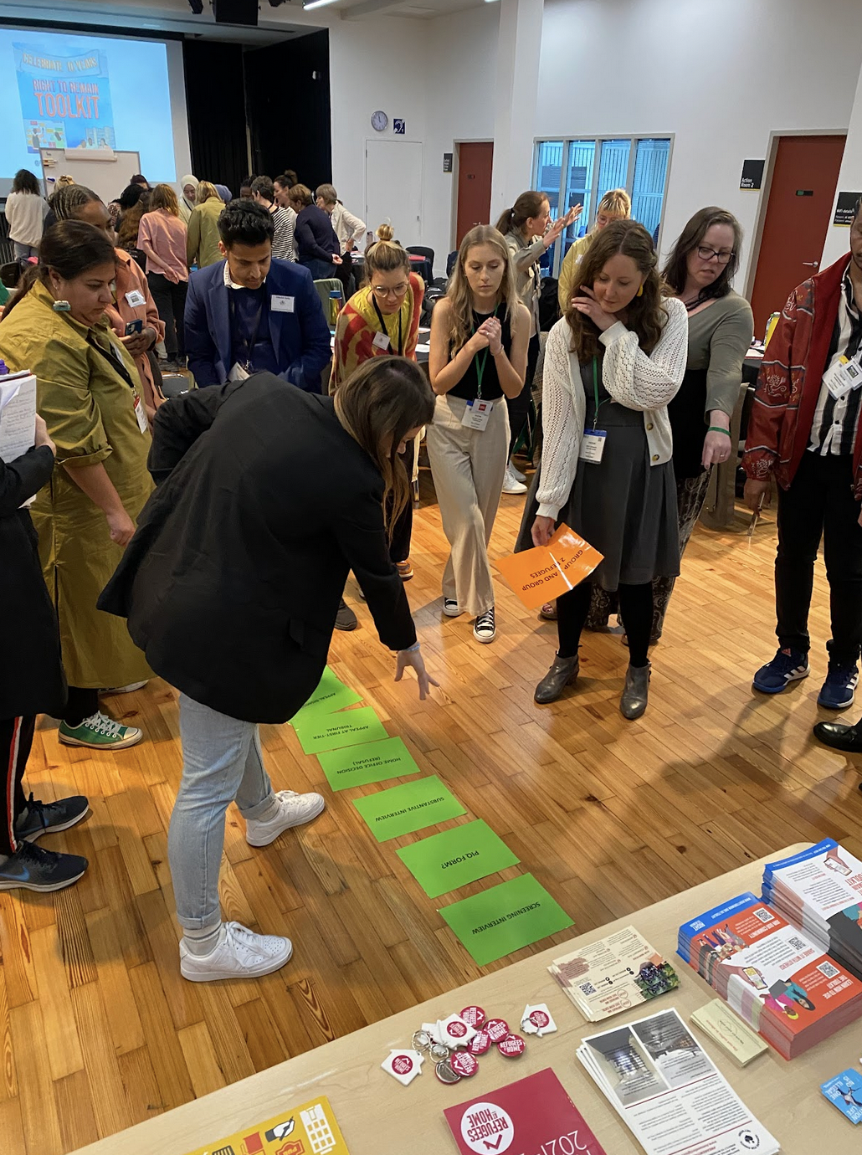
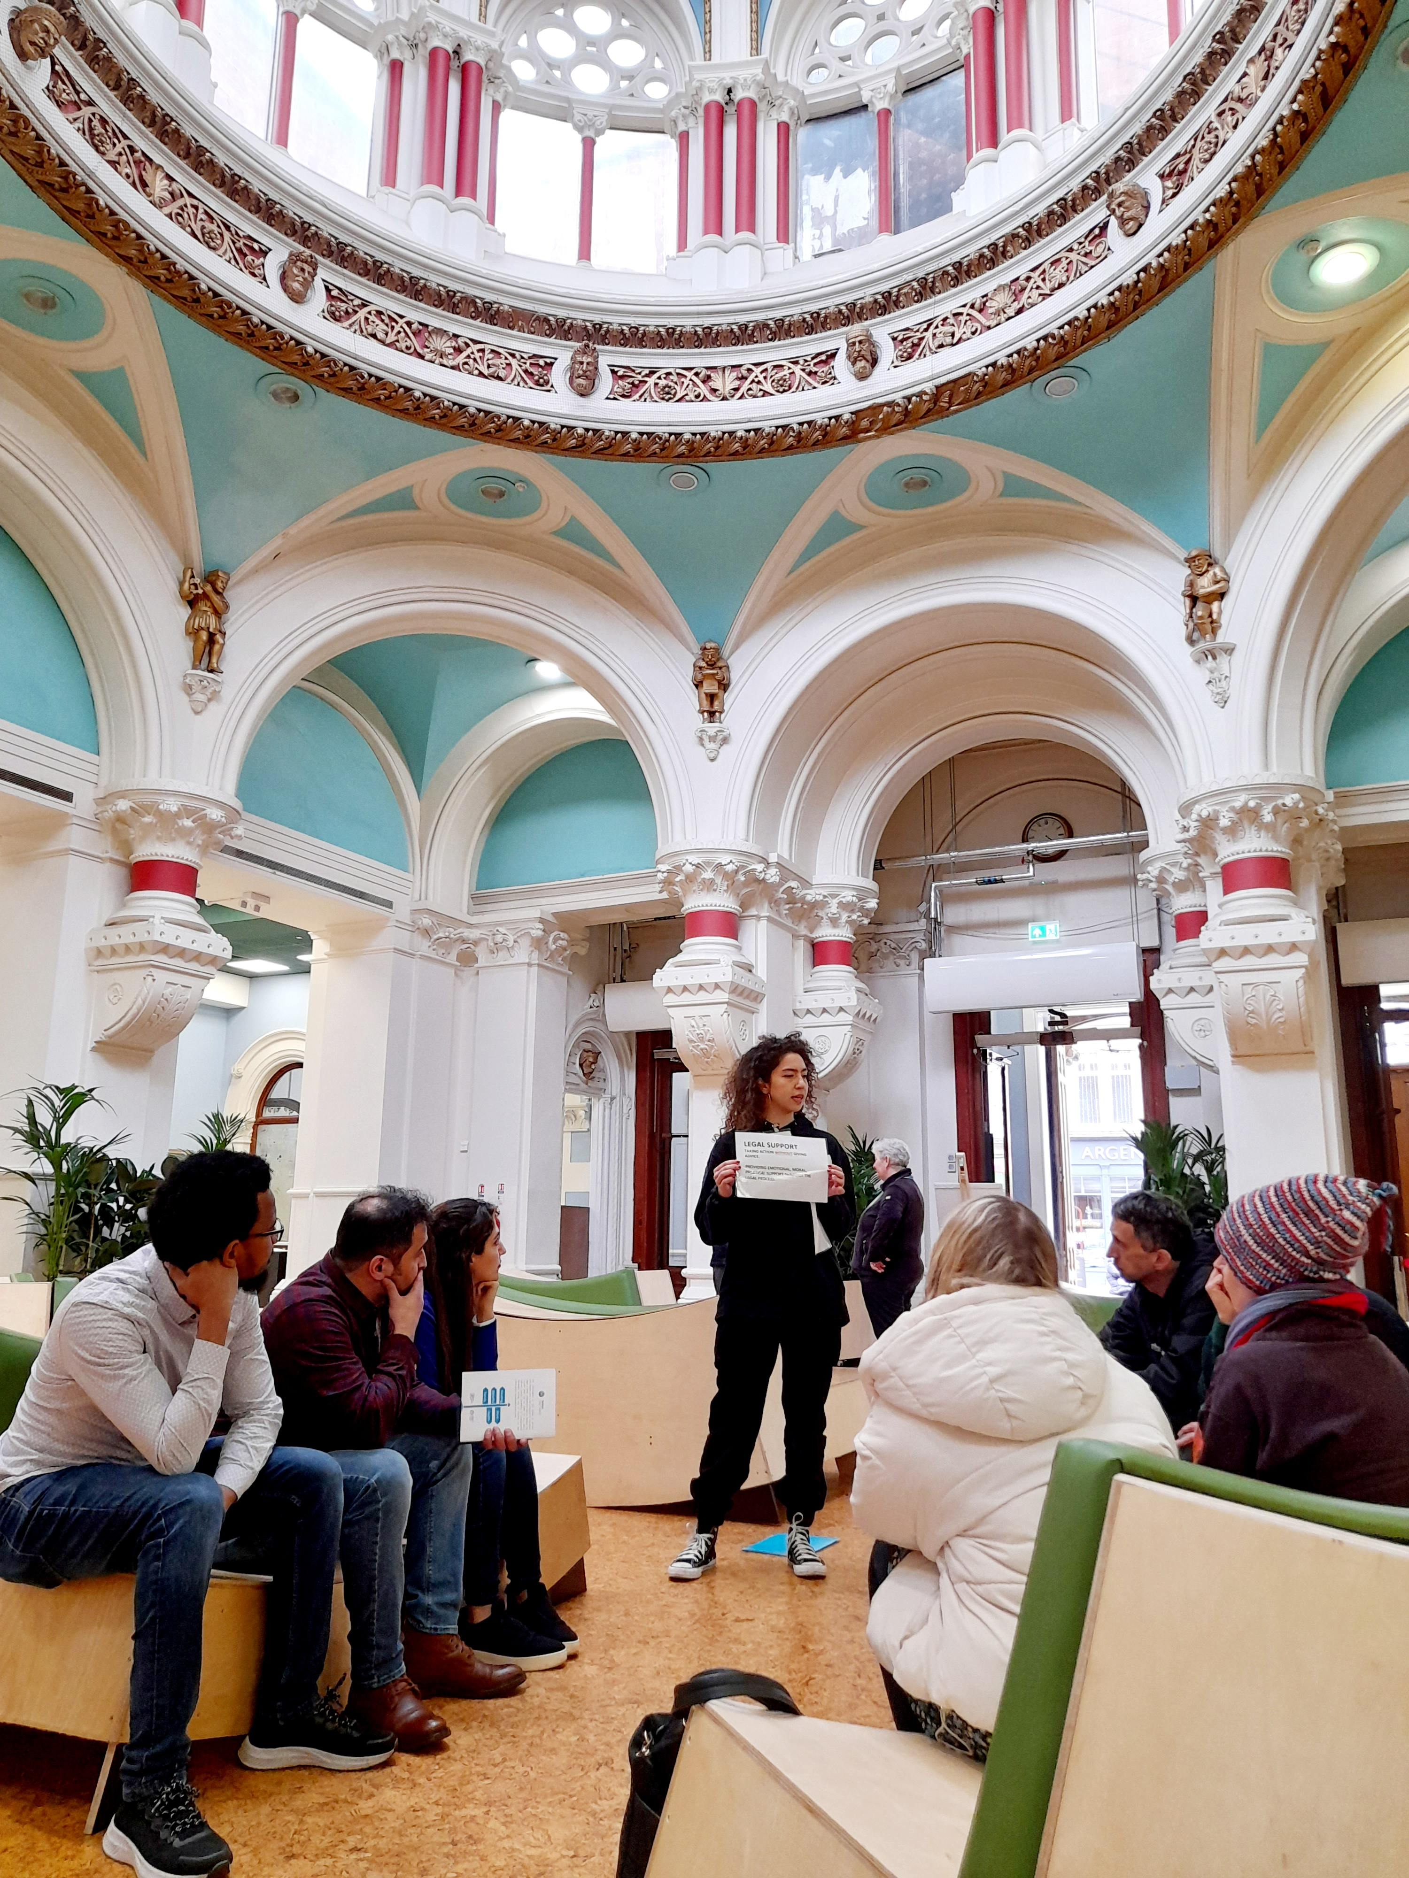

Slide 27
Case study - individual
Story of Glory

Slide 28
Case study – support workers
Story of Asylum Link Merseyside

Slide 29
Priorities?
Find out who can give legal advice on immigration and asylum in your area and check their capacity (most likely to be oversubscribed and cannot take on any referrals)
‘Mainstream’ asylum and immigration matters – it’s everyone’s concern!
Consider how to support and give information (repeatedly) to people caught up in the system – so that they know what’s happening to their situation, consider their options (they need a safe place to do this!) and what steps they could be taking while waiting
Make connections with other groups who can potentially provide legal support (not legal advice) so that people are not left alone to battle this hostile system on their own. We need more partnership and radical solidarity that cuts across ‘interest groups’.

Slide 30
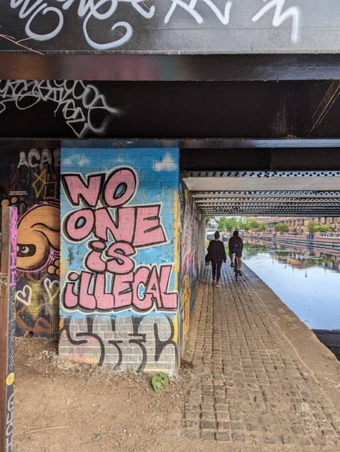
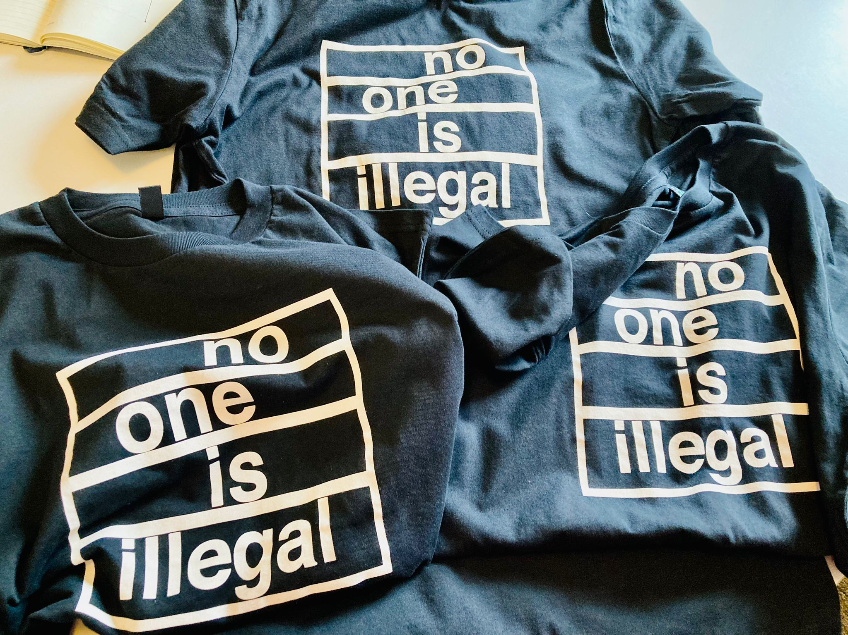

Slide 31
Working with lawyers?
It is extremely important that people know what to expect and how to work with their lawyers to avoid potential risks.
Even if you have a lawyer, it’s important to understand your own legal case – this is your case and your life and you need to keep track of what is happening and whether your lawyer is doing the things they should be.
You need to know your rights at different stages of the system, and know what the options are for the stage you are at. Knowing what could come next will help you prepare. You need to take an active role in your legal case.
https://righttoremain.org.uk/toolkit/yourlegalcase/

Slide 32
Build power with us and others
Come to Knowledge is Power online workshops (asylum) – 25 July
Invite us to talk about how to use the Toolkit (it’s not always useful to give people just the link to the Toolkit!)
Commission us to run workshops (currently on asylum only but happy to receive requests)
Receive our bite-sized legal updates
Order user-friend flyers to signpost people to the Toolkit
Come to Toolkit Festivals: Newcastle (12 July) and Worcester (27 July)
Talk to us! Campaign and fight together with us and others!

Slide 33
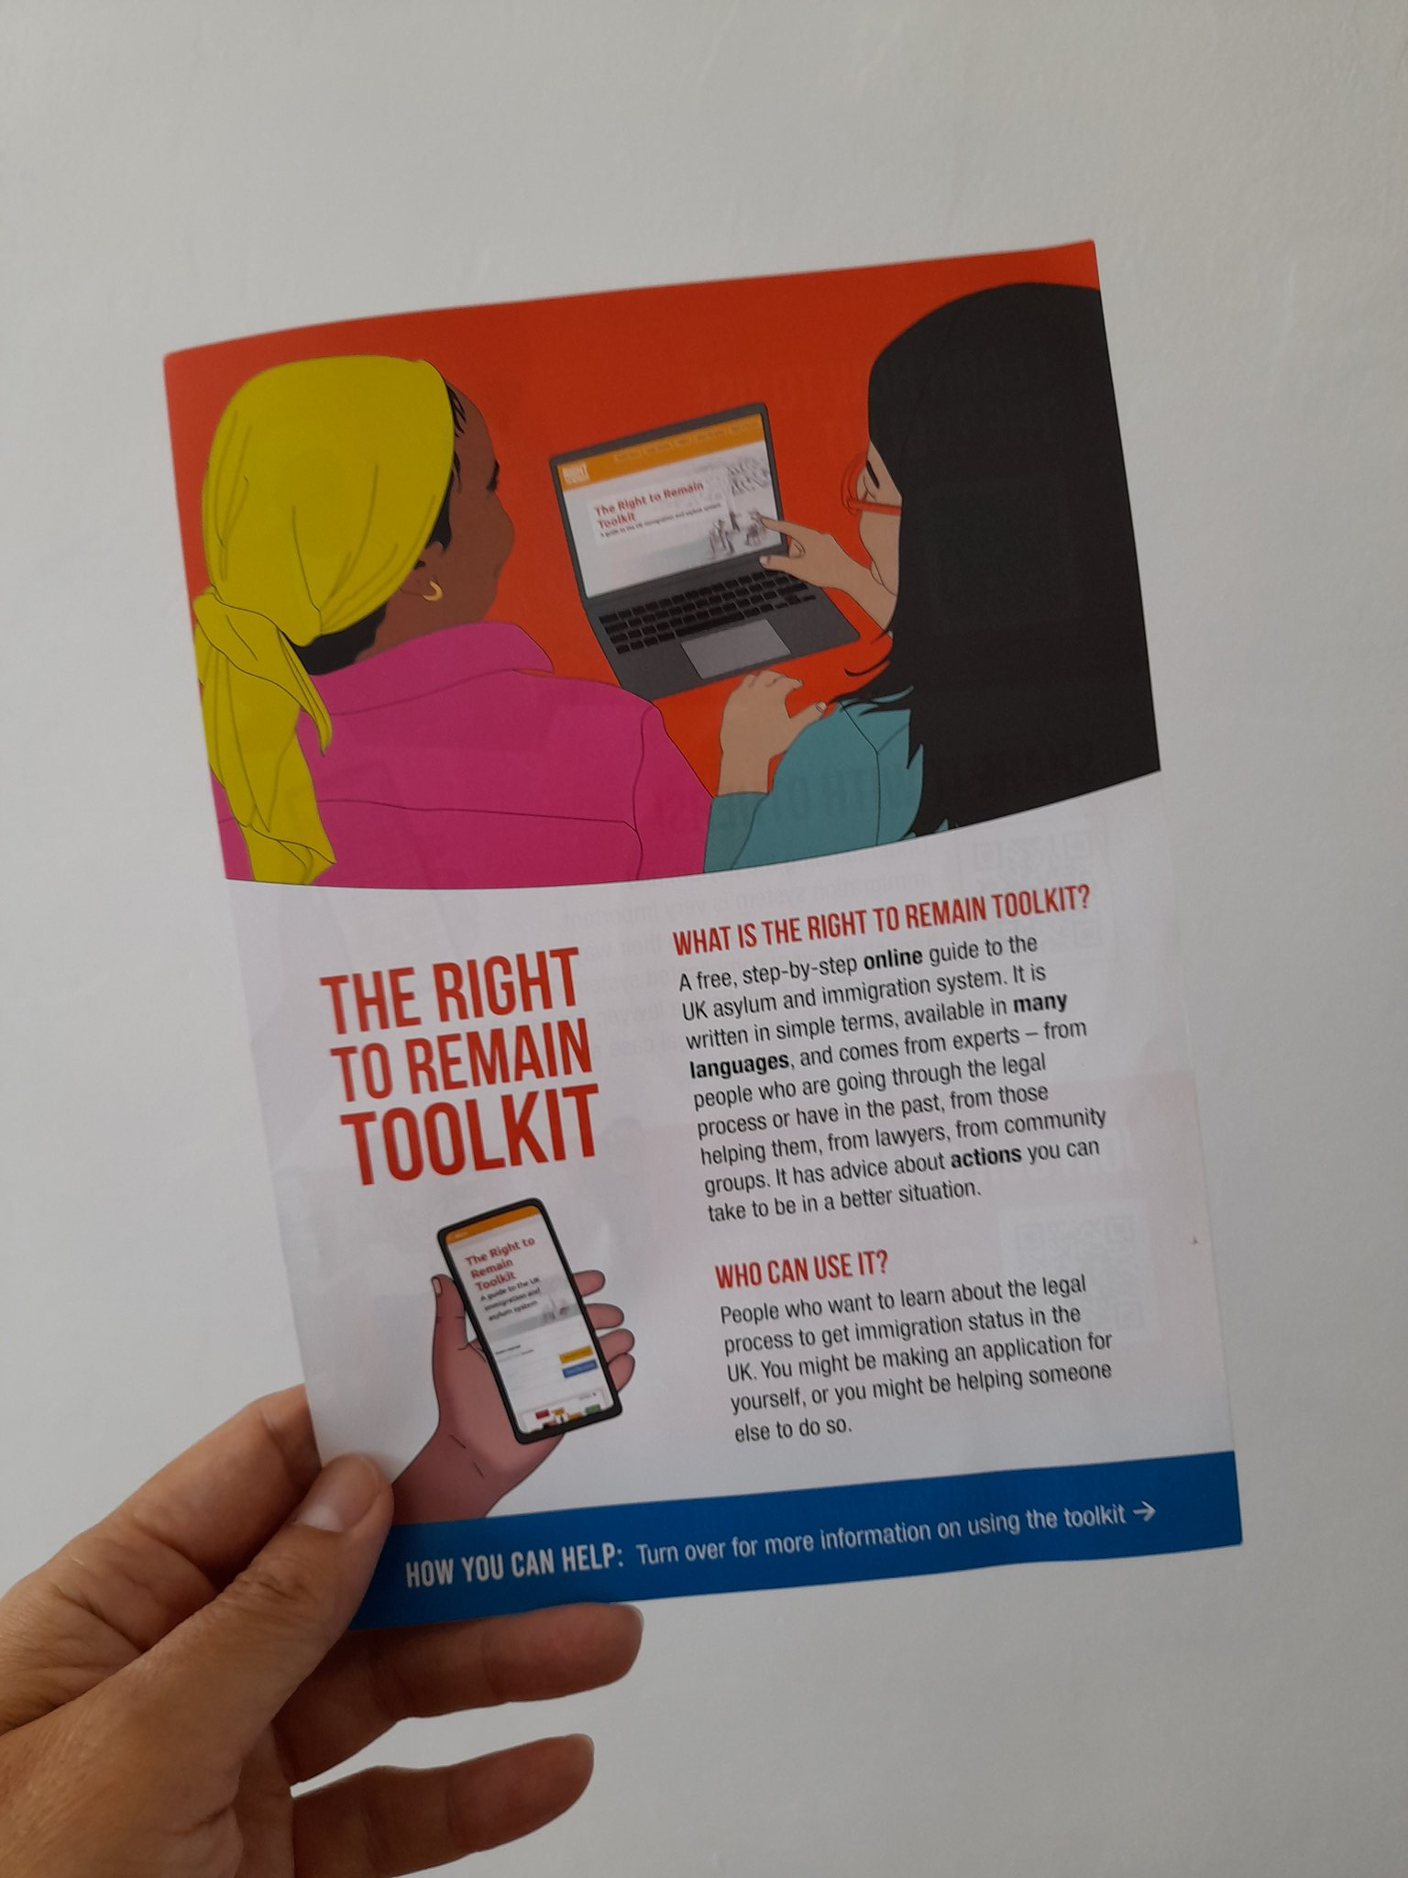
Thank you!
www.righttoremain.org.uk
@right_to_remain
Contact – Eiri Ohtani
eiri@righttoremain.org.uk
#NoOneIsIllegal

Slide 35
Housing Support
Asylum seekers – initial accommodation (Section 98), dispersal accommodation (Section 95)
Failed asylum seekers – Section 4
Refugees, LTR, ILTR, EUSS settled, some EUSS pre-settled etc. – access to social/private housing, housing support including temporary and supported accommodation
UASC – Local Authority Children’s services
Ukrainians (Homes for Ukraine) – sponsorship by UK resident

Slide 36
Combatting Destitution Project
The project aims to alleviate the causes and consequences of destitution amongst refugees and migrants in Coventry.
Aimed at failed asylum seekers and others who have no recourse to public funds due to their immigration status
www.frontlinenetwork.org.uk/funding

Slide 37
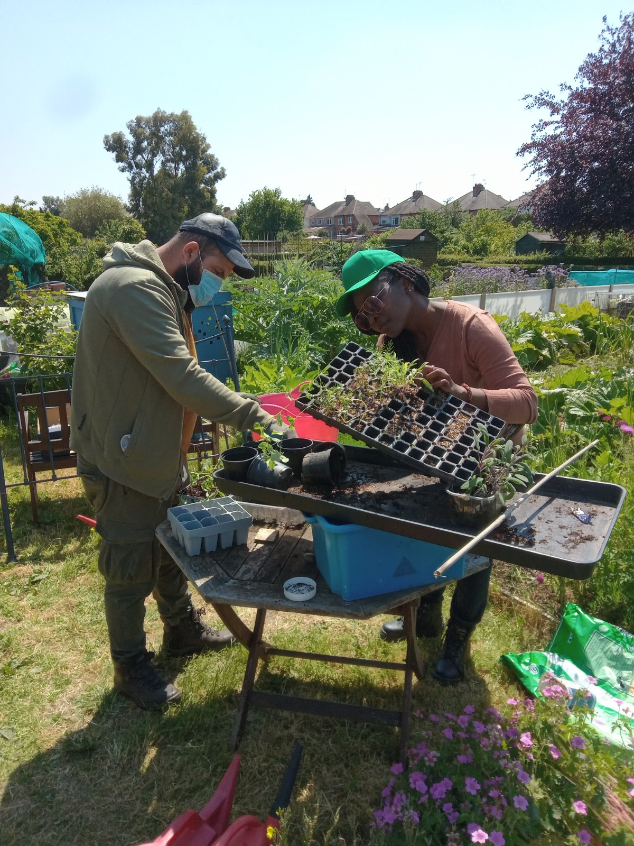
Combatting Destitution Project
Holistic and individualised support: immigration, accommodation (inc female only property), subsistence, counselling/wellbeing support, social groups/events
Qualified OISC L1/2 advisors, Destitution Officers, Rough Sleepers Outreach, Housing and Facilities staff
www.frontlinenetwork.org.uk/funding

Slide 38
Case study - Ibrahim
Ibrahim is from Nigeria and was an asylum seeker who was coerced into withdrawing his claim when he went to report as he is illiterate and did not understand what he was signing. He had been housed in a hotel during lockdown and afterwards had been rough sleeping for two months.
In addition to housing and immigration advice our needs assessment identified:
Physical health – bronchial infection and severe malnutrition
Education – client spoke English but was illiterate
Finances/Subsistence – no income
Substance misuse
Mental health – anxiety, depression, self-harm
Social support – client had no social network

Slide 39
Case study – cont.
Physical health – hospitalised for 3 weeks, was referred to mental health services, he was discharged, and we follow up with GP appointments and ensure he receives his medication for his mental health and high blood pressure
Education – attended ESOL classes for basic literacy
Finances/Subsistence – provided with cash payments/shop vouchers, food deliveries, mobile phone and supported with budgeting
Substance misuse – referred to addiction support services
Mental health – referred to our counselling services and is better able to speak about his past to support his immigration case
Housing – client was housed in one of our shared properties and provided with necessities
Immigration – allocated an immigration advisor and eventually a solicitor
Ibrahim has now moved into Section 95 accommodation

Slide 40
Case study – Omar
Omar is from Gambia and had been assaulted and had his life threatened by his family and forced to marry his cousin before he hid and fled to the UK. His asylum application was refused, he was referred to CRMC for support with a fresh claim and had no access to public funds or income.
Immigration:
Legal precedents about forced marriage/asylum claims of Gambian citizens
Country research regarding Gambia’s police/justice system, human rights, internal relocation etc – country expert and report
Professional tracing agency
Submitted a Criminal Request Check to Gambian authorities
Witness testimonies from relatives in UK and Gambia
Medical statement to support that Omar’s scars were caused by his family

Slide 41
Case study – cont.
Omar was provided with £20 a week for subsistence along with bags of food, vouchers and toiletries
Referred to Clothing Coventry
HC1 application for support with health costs – supported to find a dermatologist and purchased a blood pressure monitor for his diabetes
Supported to attend CRMC counselling sessions
Gardening group, day trip to the museums and library in Birmingham, attended First Aid training from STAR/Warwick Medical School
Omar has now welcomed a daughter with his new partner, and now eligible
for a private/family life application

Slide 42
Challenges
High level needs e.g. addiction, mental health needs, care needs
Long timescales
Service users anxious about coming forward
Service users who run out of legal options
Move on accommodation
Funding

Slide 43
Stats - Housing
Total housed: 49 (30M/19F)
Rough Sleepers: 8
Failed asylum seekers: 8
DV cases: 6
Trafficking: 2
Other LTR (family or 20 year): 2
EUSS: 2
Ukrainians: 3
Other (refugee/LTR): 18
Total Move Ons: 33
Private Accommodation: 15
Lower Support Accommodation: 1
Supported Accommodation:4
Council Housing: 2
Moved in with Friends or Family:7
Serco Accommodation: 1
Ukrainian Host Family: 2
Housing Status at Move On Unknown: 1

Slide 44
Stats - Immigration
Total immigration cases: 37
Fresh Claims: 18
Other LTR (Family or 20 year): 8
Trafficking: 2
Voluntary Return: 1
DDVC and SETDV ILR: 5
EUSS: 3
Total outcomes: 10
Successful Fresh Claims: 2
Successful Initial Claim: 1
Successful LTR as Parent of a British Child: 2
Successful Voluntary Return: 1
Successful SET DV ILR: 1
Successful EUSS: 3

Slide 45
Questions?

