Slide 1
Perfecting the art of street outreach - a work in progress…..
Jan Keauffling, QN
Nurse Specialist Homeless & Vulnerable Adults, Swansea

Slide 2
Where it all started…
2005 a new post based in a day centre providing food and support for homeless & vulnerably housed
Pilot project to see if people experiencing homeless & vulnerable housing had health needs
The enthusiastic amateur
Street Outreach wasn’t on the plan
Notes:
In 2005 I applied to run an 18 month pilot project to determine the health needs of people experiencing homelessness or vulnerable housing (hostels, wet houses etc).
I was given a couple of rooms at a day centre and set about answering the question by providing opportunistic nurse led services including health checks, dressings, blood tests, registration with a GP, immunisations etc.
As the enthusiastic amateur, with absolutely no experience of homelessness, and everyone around me in the same position, I had no idea what I might be missing.

Slide 3
Developing outreach
Outreach to undertake BBV testing and HBV immunisations at a local drug project
Outreach to hostels, wet houses and other supported accommodation
Outreach with street sex work team
Street Outreach
Closure of the centre
Pre-Covid: Mornings - open access clinic; Afternoons – Outreach
Now based at a GP surgery in central Swansea
Some patients come to the surgery; flexible
The rest is outreach
Notes:
The opportunities of outreach began a year or so later when I had met with some workers from a local drug project. They wanted access to BBV testing and HBV / HAV immunisation for their clients, so I agreed to visit their project once a week on a Wednesday afternoon. Later I teamed up with an outreach worker from the Integrated Sexual Health Service at the hospital and we were able to offer a whole range of care to people. We wrote up our work and started providing training resources to people working outside of the health services to help them manage their clients. Eventually, I found myself part of the team providing opportunistic care to street sex workers.
Every day after my clinic at the centre I would provide outreach to hostels and wet houses – going to see those who were unable or unwilling to attend mainstream services – and there were many. As I walked around the city I found places that were regularly used by homeless folk and those with drug and alcohol issues. I found myself being stopped and asked questions, making appointments and problem solving.
When the centre closed in 2015 I lost my clinical space (truly the homeless nurse now!) and I was given temporary accommodation with one of the support teams where I continued to provide an open access health service in the mornings and outreach in the afternoons.
Now I have to provide some care such as dressings in the surgery, the rest is outreach.
Often they had been highlighted as having attended the local emergency

Slide 4
Street Outreach – a world of opportunities
To see people “where they are at” – good way of capturing trends in substance misuse
To see people who otherwise would not attend a clinic/appointment
To detect health problems earlier
To detect possible abuse / safeguarding issues
For health promotion & harm reduction
To sit and talk in an informal way to develop engagement
For joint working with other agencies
To test the waterproofing of coats and shoes….
Notes:
I have many stories about street outreach – finding someone with sepsis and getting them to hospital in the nick of time but most are more mundane but no less important – spotting cellulitis and arranging urgent antibiotics; observing probable financial abuse of a man with learning disabilities; giving out condoms; treating sunstroke; and the memorable day when 6 alcohol dependent people all blamed each other for having head lice. It is a vitally important part of seeing which substances are top of the pops and the dangers posed.
But by far and away, the most important aspect of street outreach is to see and be seen, to acknowledge and to be available for a chat, for it is here that real engagement with health begins.

Slide 5
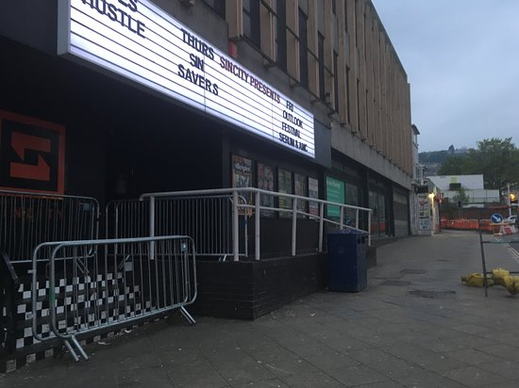
Images from Swansea Evening Post Archive

Slide 6
Challenges
No risk assessments before you go as you have no idea who you will see
Difficulties of managing examinations
Reliance on street outreach as a way of managing their healthcare
Testing the waterproofing of coats and shoes….
Notes:
Its not all roses out there.

Slide 7
Janet.Keauffling@wales.nhs.uk

